Slide 1
Sensorssss
Vishal Jagannathan

Slide 2
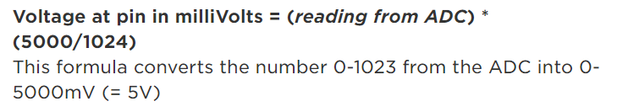
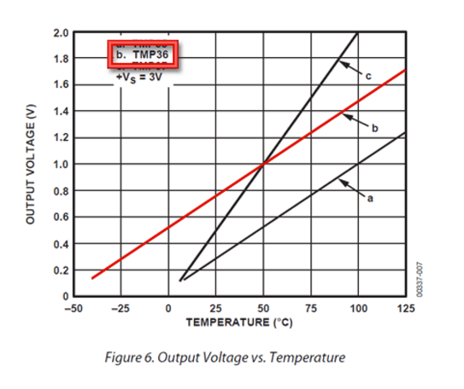
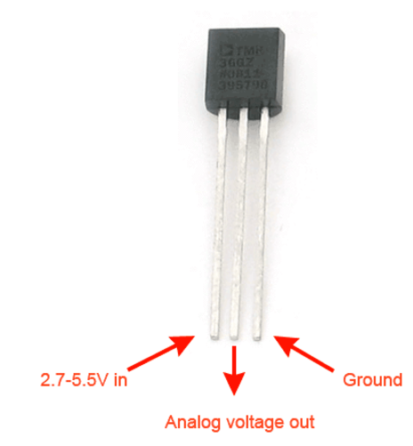
Thermal
The output voltage changes based on the temperature
Note the conversion factor is based off the microcontroller’s (Arduino’s) analog reading
5V is the max pin voltage for this
specific microcontroller

Slide 3
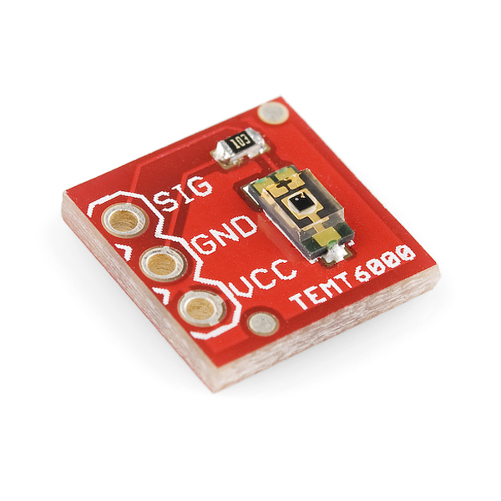
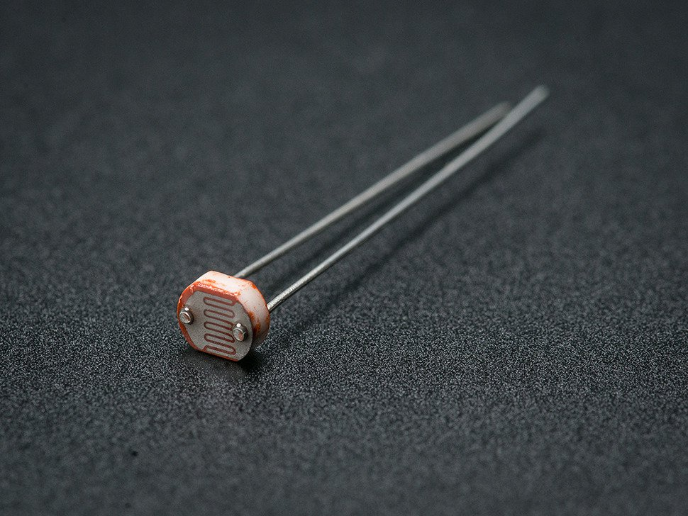
Photoresistor and Light Sensor

Slide 4
Photoresistor
Acts as a resistor
5-10KΩ in light, 200KΩ in the dark
Can be read by the Arduino as
a normal resistor, up to the user
To make a meaningful interpretation of the data
(put serial log pic here)

Slide 5
Light Sensor
Acts as a transistor
More light = sends more voltage to the
analog pin
This particular picture is a breakout board
for Arduino and similar devices

Slide 6
Photoresistor and Light Sensor
Both serve the same purpose: determine surrounding light levels
Different implementations but in both cases the voltage on the analog pin is higher in lighted scenarios
Different Photoresistors and light sensors act differently so it is important to look at the specification sheet of the particular device you are using!

Slide 7
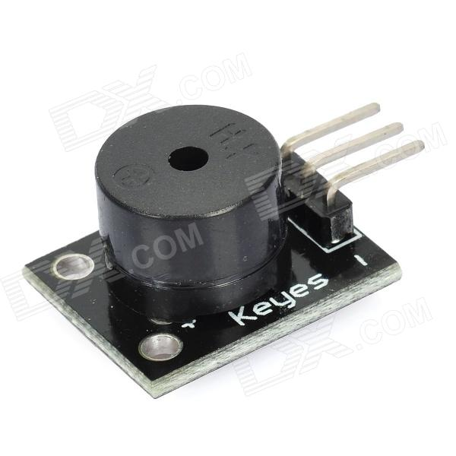
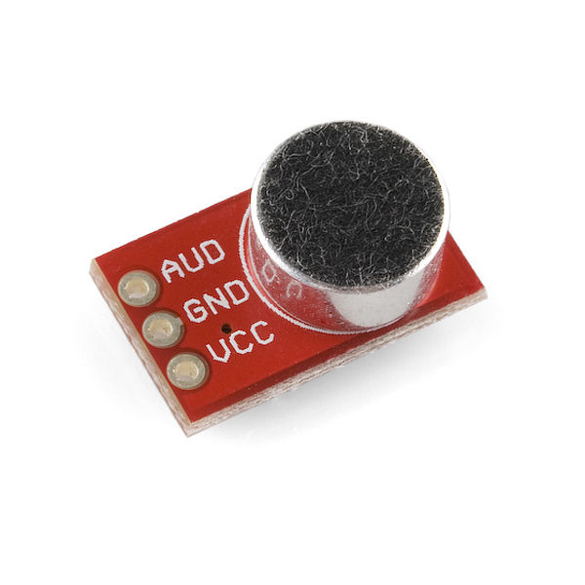
Mic and Speaker
Technically a speaker/buzzer module

Slide 8
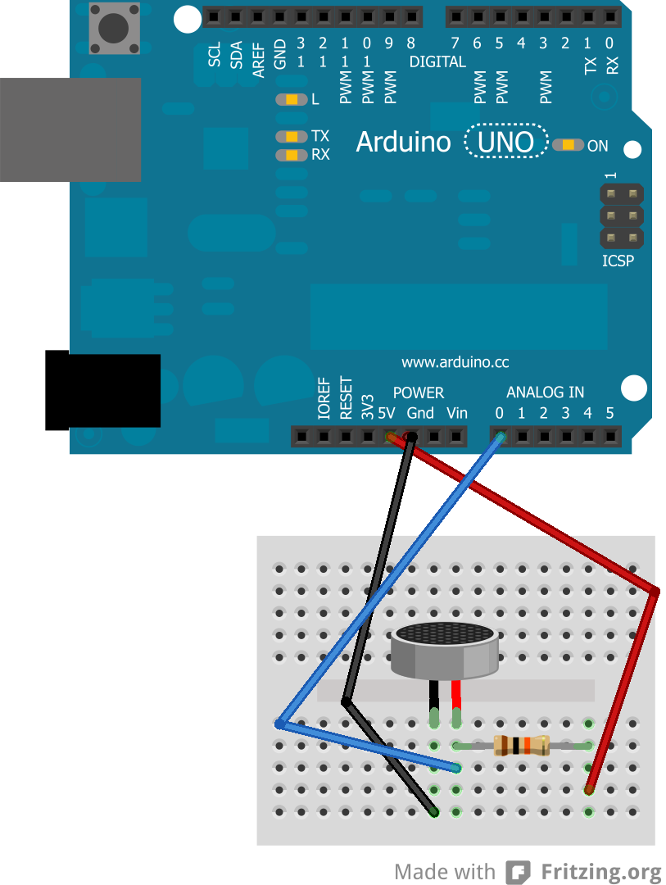
Mic
When sound waves hit the mic, it is
converted into an electrical signal
Read here by the analog input A0.
The Arduino can then interpret this
Information and act on it
For example….

Slide 9
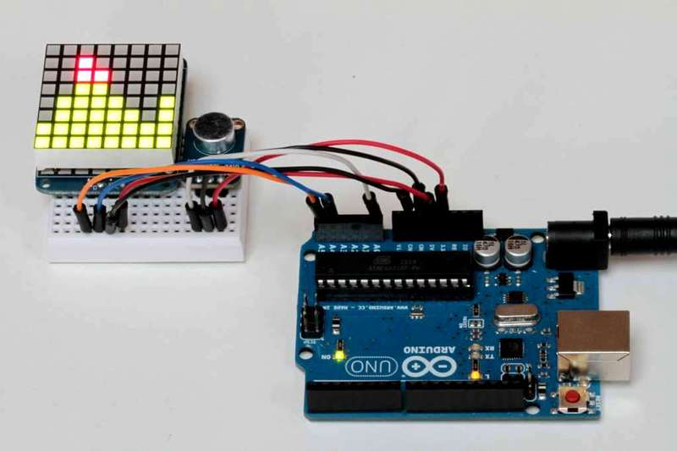
Cool thing that looks like an equalizer

Slide 10
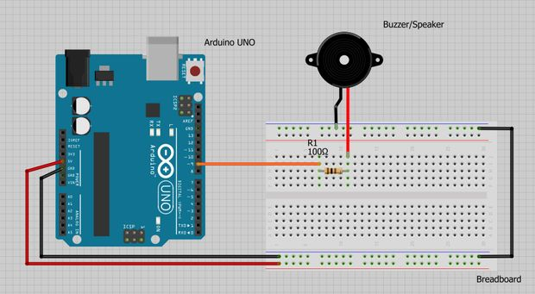
Speaker
The reverse of a mic, this
Device converts the electrical
Signals into sound waves.
(2x check this) To use this, the output wire to the speaker must support Pulse Width Modulation (PWM, denoted by ~ on an Arduino), meaning that you can specify a voltage value from 0 – 5V
This gives control ove

Slide 11
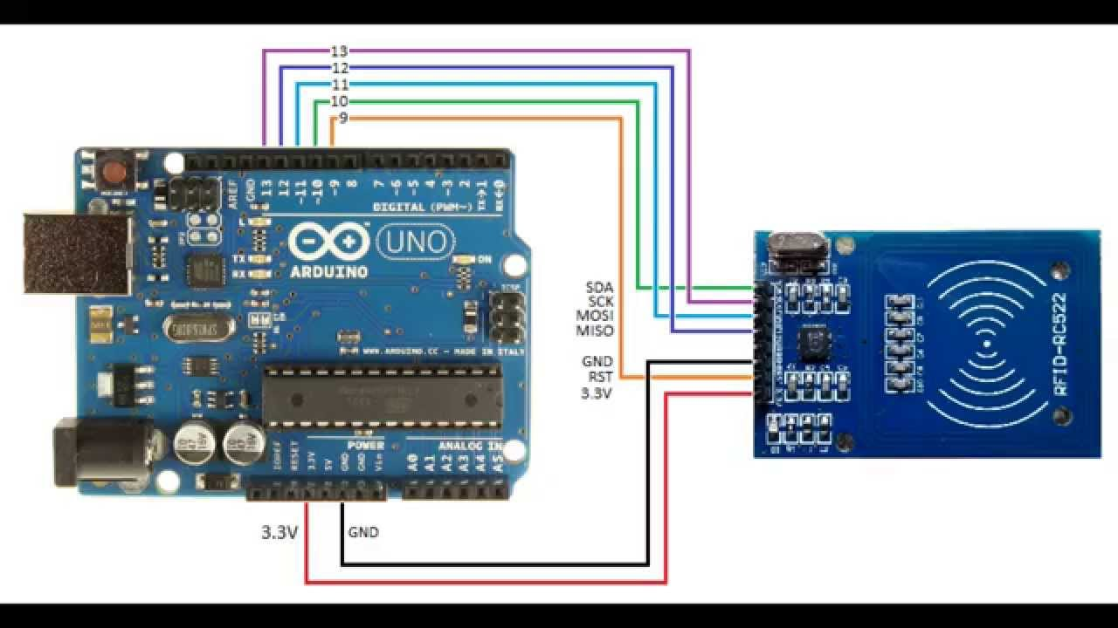
RFID

Slide 12
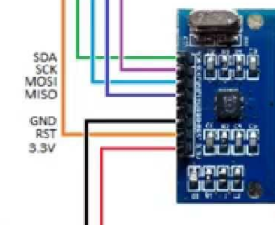
Closer Look
Data
Power
This is used to sign-in here!
Note that this input is 3.3V
Simply put, data is sent over SDA, SCK, MOSI, MISO when an RFID tag is tapped to the sensing area of the board
This specific chip can also write data to RFID chips

Slide 13
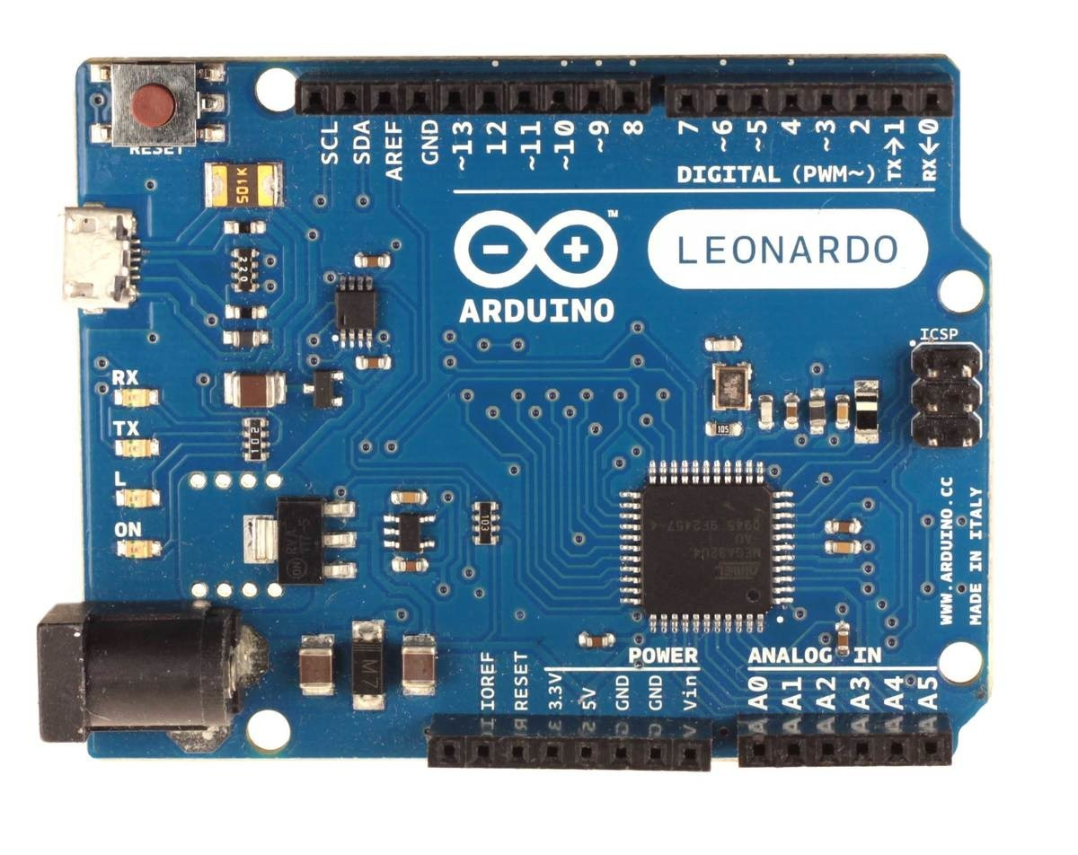
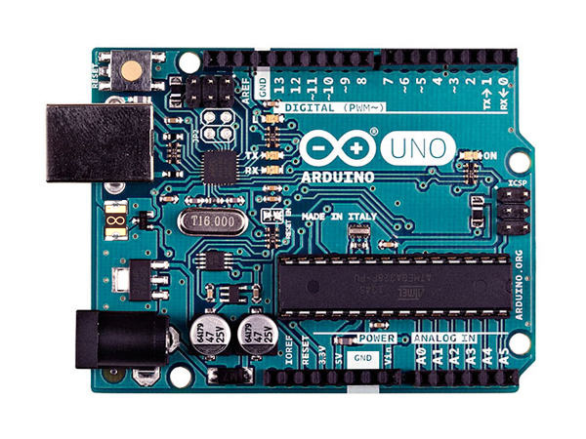
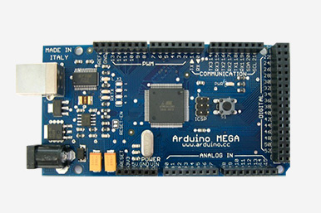
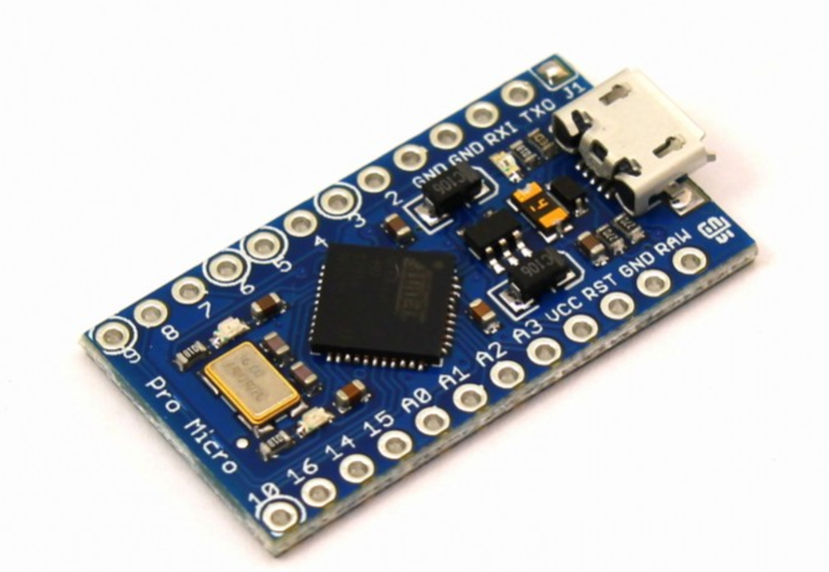
Arduino

Slide 14
Details – Arduino Uno
Copy stuff from specs page

Slide 15
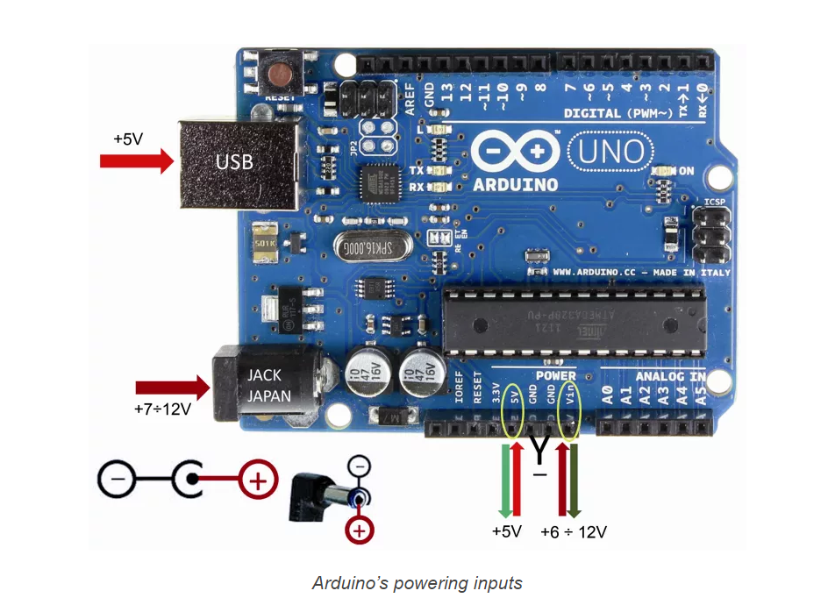
Arduino Power
Notes:
https://www.open-electronics.org/the-power-of-arduino-this-unknown/

Slide 16
Arduino Communication
Arduinos have analog and digital pins
Digital:
Can send power 0 – 5V (or 3.3V on some other Arudino models)
Special PWM pins (denoted by ~) can send between 0 and 5V
Can read inputs, but not the intensity of it (just on or off)
Analog
Can only read, but can read the intensity of an input
Reported as a number between 0 – 1023 (scaled 0 – 5V)

Slide 17
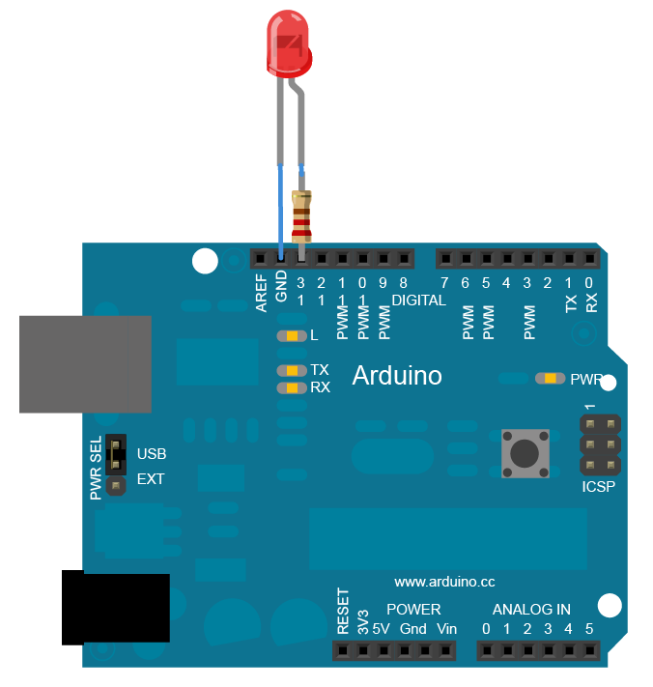
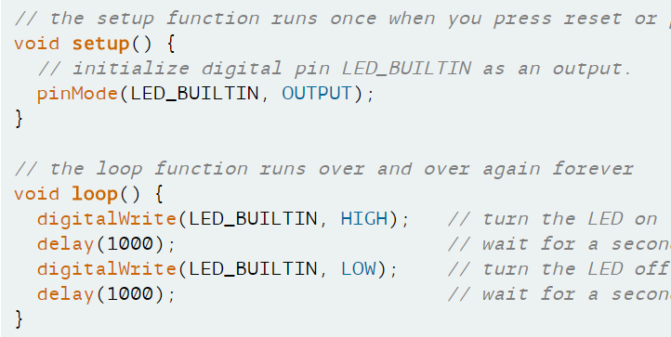
Power output
Ground
(LED_BUILTIN = 13)
Note: Times are always given in Milliseconds
Notes:
https://www.arduino.cc/en/Tutorial/Blink

